Slide 1
Introduction to HTML
Sandeep G

Slide 2
Who Am I?
Engineer / Front End developer
Worked in Software AG, MSFT, SAP
~9 years of experience
Worked in React JS, TypeScript, JS, CSS, HTML
With Almabetter from last 8 months with average of 88% rating
Right now -
In Bangalore, city of garden
Love to do competitive programing
In my leisure time trekking and chess

Slide 3
Good to know
First 45 mins Q&A, doubt clearing session
Use you live chat to ask questions in the classroom. Question with maximum upvotes will be considered
Please do your assignments regularly
Make study groups, for maximum outcomes

Slide 4
Web Development
An engineer who manages websites(build, maintaining)
Involves making of webpage, which would work over internet, intranet
Includes works like -
web design,
web publishing,
web programming,
database management.

Slide 5
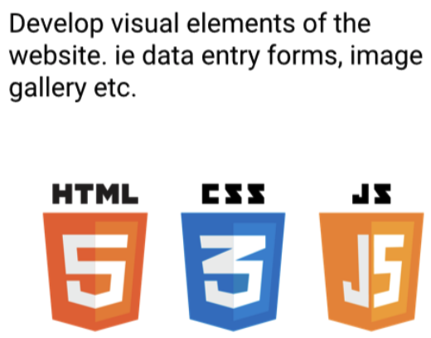

Classification of web development
Frontend development Backend Development

Slide 6
Front end development
Designing the look and feel of the website
Think about the user’s experience and how they would interact
User experience includes: access to content, ease of navigation and elegant functionality of elements on the website, and more.
Simple definition - “Practice of producing HTML, CSS and JavaScript for a website or Web Application so that a user can see and interact with them directly.

Slide 7

Front end libraries
CSS Libraries - Bootstrap, Tailwind CSS, Material UI.
Javascript Libraries - React Js, Angular Js, Vue Js.
Front dev. Stack - 1. MEAN Stack: Mongodb, Express, Angular JS, Node JS 2. MERN Stack: Mongodb, Express, Angular JS React JS, Node JS

Slide 8
Web page
Document written in HTML and can be viewed in any browser.
Hosted on a web server, which can be accessed by a unique URL.
Contain text, links for other pages, graphics, videos, etc. to convey information to users
Written in HTML, styled by CSS, interacted via JS
Group of webpages is called website.
E.g. of a website which contains - 1. Only videos. 2. Only Images. 3. Text, Images and sometimes videos.

Slide 9
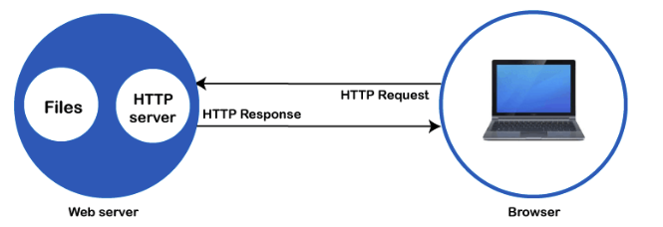
Working of web page
Created using HTML - a markup language, in order to format the text/info
Css to style the layout and JS is used when we are interacting with the page.
How it works

Slide 10

What is HTML
Building block of any web page, stands for “Hypertext Markup Language”
Markup language - A computer language that defines the structure and presentation of raw text.
Computer can interpret text wrapper in HTML.
Hypertext - text in a webpage, which link to another webpage/texts, through links called hyperlinks.
Its NOT. a programming language, it’s a markup language to format document
Structure & markup is important for users to get the gist of the information in Any document, be it newspaper, T&C document or a web page.

Slide 11
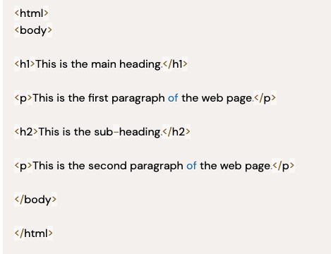
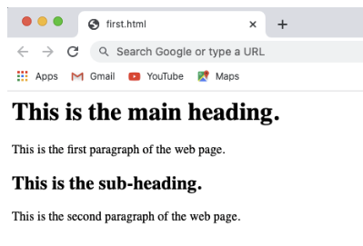
HTML
HTML code to markup out website’s raw data with identifying tags
With these identifying tags browser come to know about the type of data. E.g. image, text, video, etc.

Slide 12
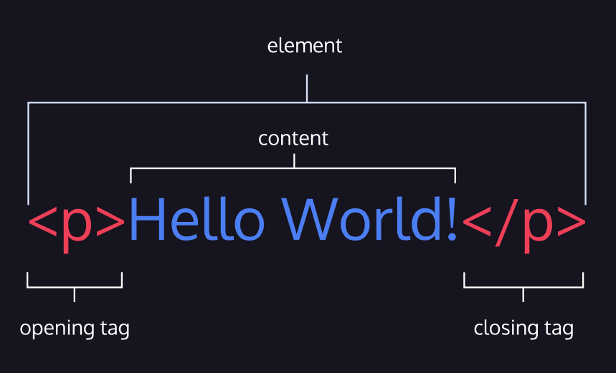
HTML code
The opening <html> tag indicates that anything between it and a closing </html> tag is HTML code.
The <body> tag indicates that anything between it and a closing </body> tag should be shown in the main window of the browser.
<h1>: indicates heading
<p>: indicates paragraph

Slide 13
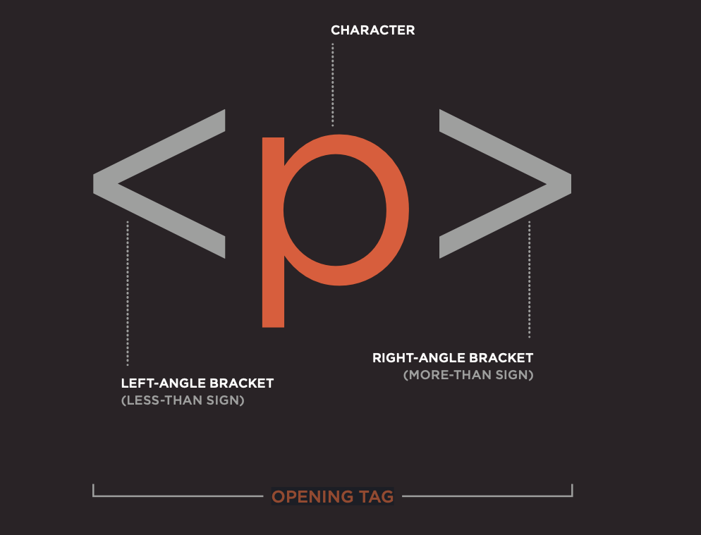
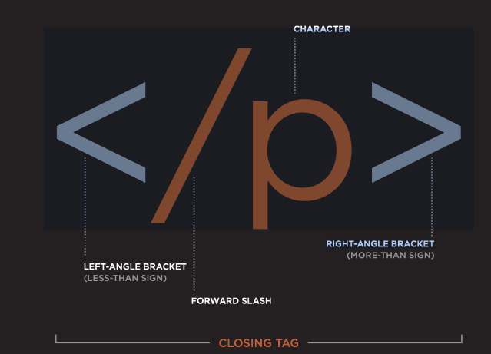
HTML Element

Slide 14
HTML Element vs Tag
Element contains open and close tag, with the information in between the tags.
Tags act like containers, which tell something about the information between the tags.

Slide 15
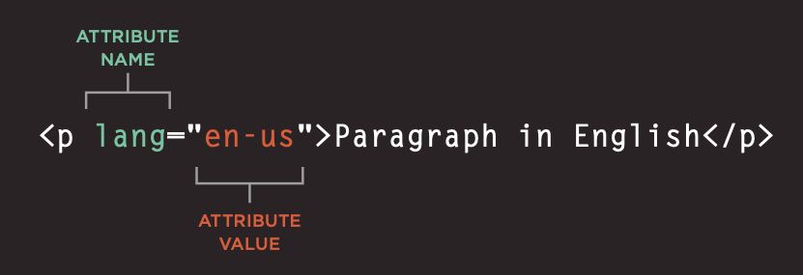
Attributes in HTML tags
Gives additional information about the tags

Slide 16
Main elements of HTML

Slide 17
<HTML>
Root of an HTML element
All content/structure for an HTML document should be contained between the opening and closing <html> tags
Tells the browser that the code between these tags is html code.

Slide 18
Document type declaration
<!DOCTYPE html> is required as the first line of an HTML document.
It is an instruction to the browser about what type of document to expect and which version of HTML is being used, in this case it’s HTML5.

Slide 19
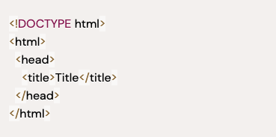
<Head> and <Title>element
Contains general information about an HTML page.
The information inside is called metadata.
Includes things like - title of the webpage and links to stylesheet
Title element defines the title of an HTML document

Slide 20
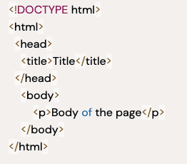
Body element
Represents content of the HTML document
Content inside <body> tags are rendered on the web browsers.

Slide 21
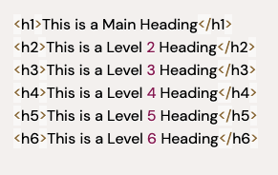
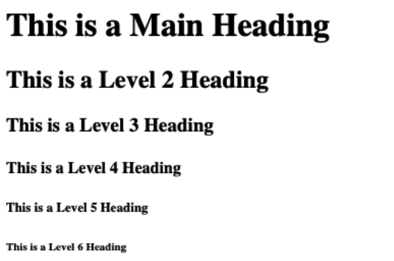
Heading tags in HTML

Slide 22
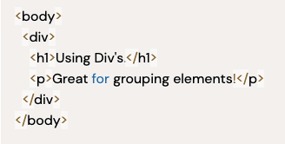
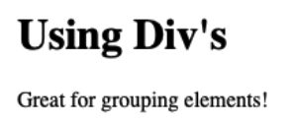
Div tags
Used as a container that divides an HTML document into sections and is short for “division”.
<div> elements can contain flow content such as headings, paragraphs, links, images, etc.
<div>'s don’t inherently have a visual representation, but they are very useful when we want to apply custom styles to our HTML elements

Slide 23
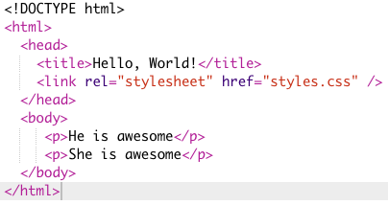

Paragraph tags
To create a paragraph, surround the words that make up the paragraph with an opening <p> tag and closing </p> tag
Browser will show each paragraph on a new line with some space between it and any subsequent paragraphs

Slide 24
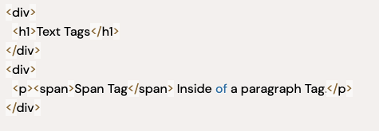
Span Tag
<span> contains short pieces of text or other HTML.
They are used to separate small pieces of content that are on the same line as other content.

Slide 25
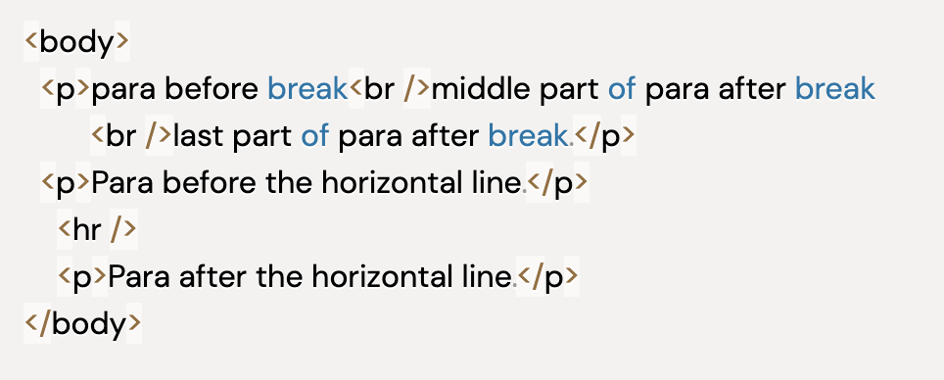
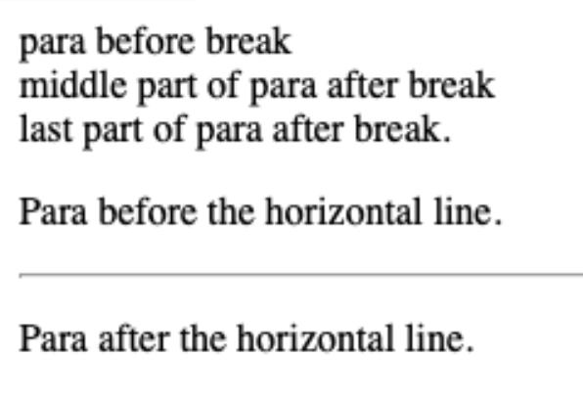
HTML self closing tag
A self closing tags in HTML are the type of HTML Tags that need not to be closed manually by its closing tag, which means there is no separate closing tag for it as </tag>.
E.g. <img />, <input />, <br />, <hr />, etc.
Also known as void tags, empty tags, singletons tags
<br/> tag - line break
<hr/> Horizontal line tag

Slide 26
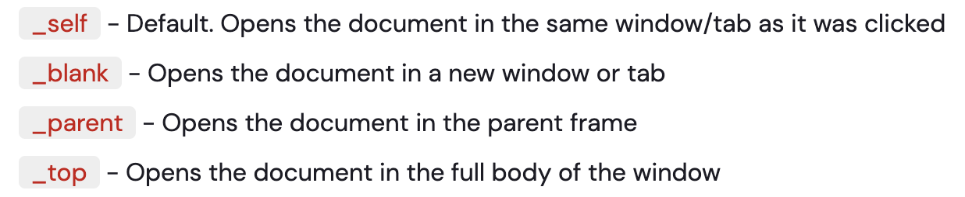
Anchor tag
Defines a hyperlink i.e. you can click on a link and jump to another document.
E.g.
Href attribute indicates the link destination.
Visit AlmaBetter will be shown, clicking of https://www.almabetter.com would open.
Link will appear as follows -
An unvisited link is underlined and blue
A visited link is underlined and purple
An active link is underlined and red
Target attribute in anchor tag, specifies where to open linked document

Slide 27
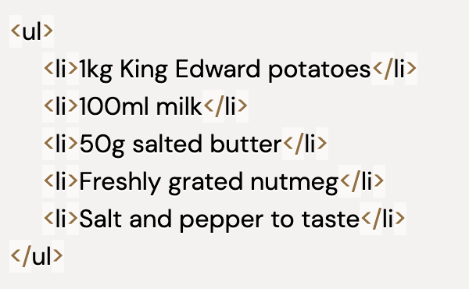
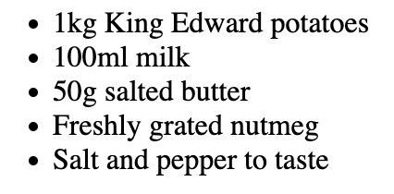
Lists in HTML:<ul>
<ul></ul> - Unordered list tag: Create a list of items in no particular order.
An unordered list outlines individual list items with a bullet point.
Each item in the list is placed between an opening <li> tag and a closing </li> tag.

Slide 28
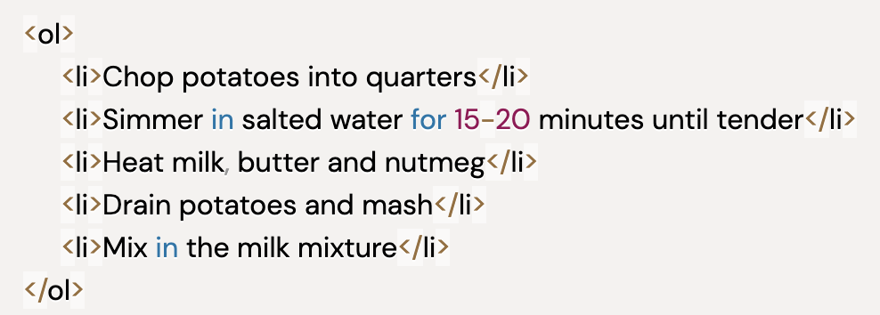
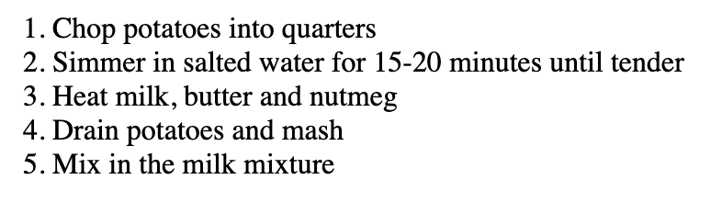
Ordered list tag <ol>
Ordered lists (<ol>) are like unordered lists, except that each list item is numbered
Useful when you need to list different steps in a process or rank items for first to last.

Slide 29
Image tag
To add an image into the page you need to use an <img> element
This is a self closing tag
Attribute list -
Src: Tells the browser where it can find the image file.
Alt: Provides a text description of the image which describes the image if you cannot see it.
Title: Provide additional information about the image.
Height, width: Attributes specify the size of image on the page.

Slide 30
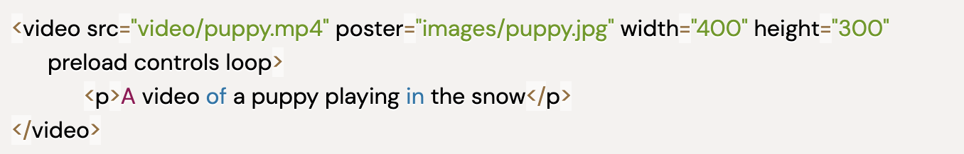
Video Tag
To add an video into the page you need to use an <video> element.
Attributes -
Src: Specifies the path to the video.
Controls: Indicates that the browser should supply its own controls for playback.
Autoplay: Specifies that the file should play automatically
Loop: Indicates that the video should start playing again once it has ended.
Preload: tells the browser what to do when the page loads.
height, width: specify the size of the player in pixels.

Slide 31
Button tag
Used to create a clickable button within HTML form on your webpage.
You can put content like text or image within the <button>........</button> tag.
You should always specify the type attribute for a <button> tag. Different browsers use different default type for the button element.

Slide 32
More HTML elements
In next lecture

Slide 33
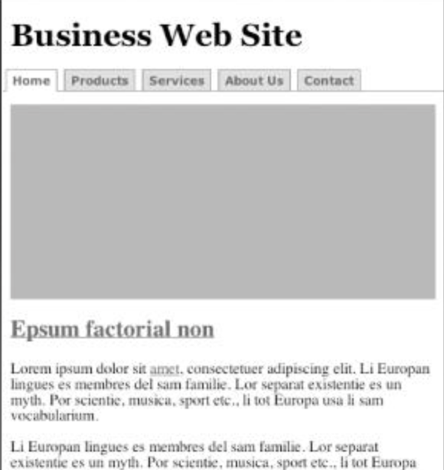
Assignment
Create a webpage which should look like a news website.
Read about 10 new HTML elements

Slide 34
Thanks and Happy coding!

